Slide 1
ASP.NET CORE, PEEK INTO THE FUTURE
By Expert Network
@FII Practic

Slide 2
ASP.NET CORE, FINALLY PEEKING INTO THE FUTURE

Slide 3
ASP.NET CORE
Cross-platform, high performance, open-source framework for building modern, cloud-based applications.

Slide 4
ASP.NET CORE - Cross-platform
Write it once, run it everywhere
Works on:
Linux (Red Hat, CentOS, Oracle, Fedora, Debian, Ubuntu, Alpine)
Windows (7, 8.1, 10, Server 2012, Nano Server, Server 2019)
macOS (High Sierra, Sierra)

Slide 5
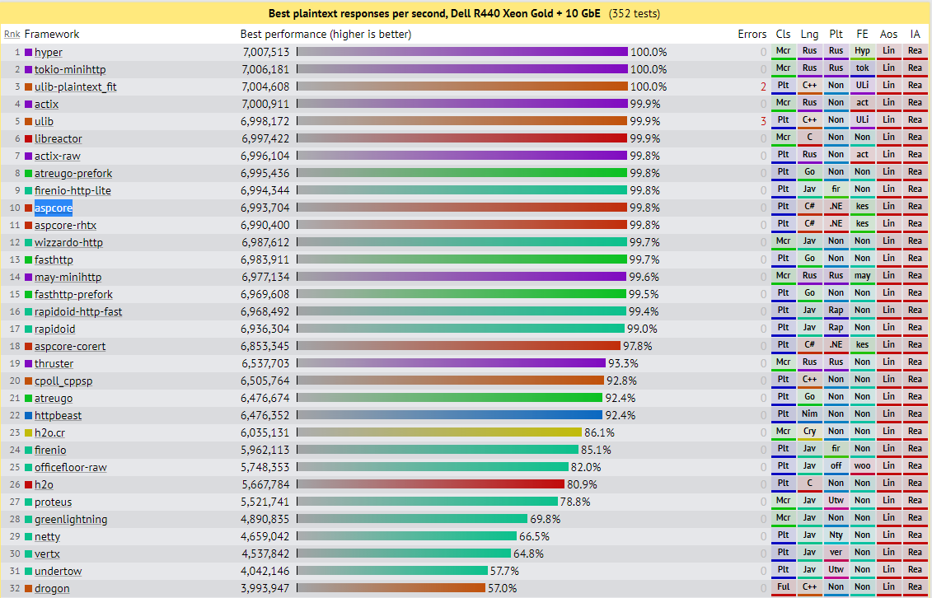
ASP.NET CORE - High performance

Slide 6
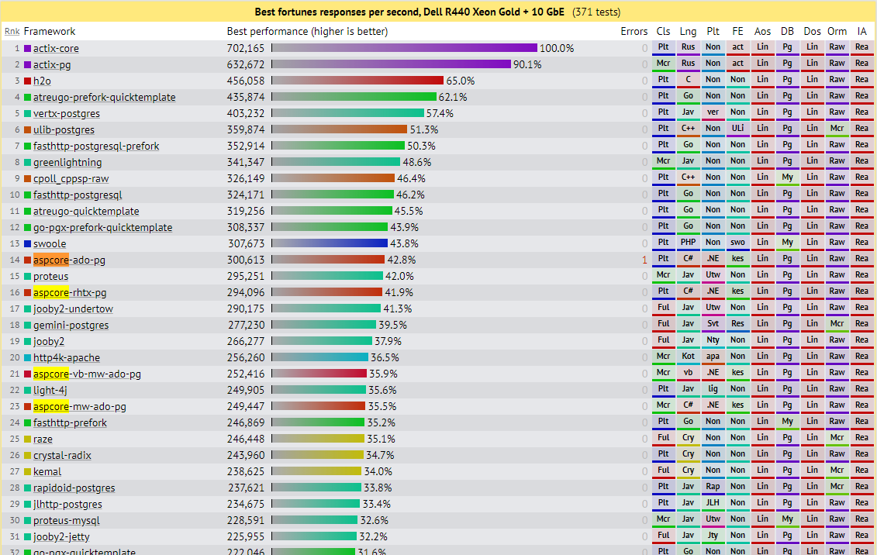
ASP.NET CORE - High performance

Slide 7
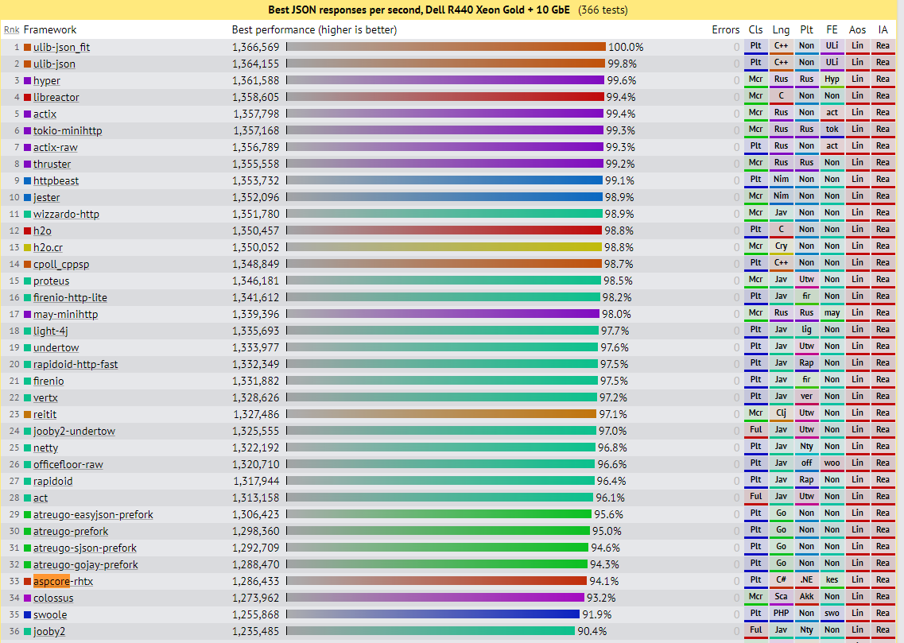
ASP.NET CORE - High performance

Slide 8
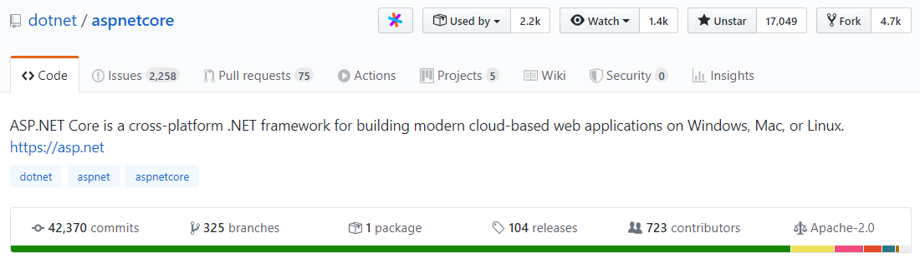
ASP.NET CORE - Open-source

Slide 9
WHY?
Redesign of ASP.NET 4.x, with architectural changes that result in a leaner, more modular framework
Can build web UIs and web APIs
Integrates modern, client-side frameworks and development flows
Built-in dependency injection.
A lightweight, high-performance, and modular HTTP request pipeline.
Ability to build and run on Windows, macOS, and Linux
Open-source and community focused

Slide 10
ASP.NET CORE Application models
Razor Pages
MVVM (Model-View-View-Model) (~ Windows Forms / WPF)
Two-way data binding
Use it for small applications (a couple of pages)
MVC
Model-View-Controller approach
Excellent for enterprise applications
Blazor
Cool new kid in town
Use C# on backend AND frontend (instead of JavaScript)
Webassembly
Applications are based on components (element of UI, such as a page, dialog, or data entry form)

Slide 11
Prerequisite: HTTP

Slide 12
WHAT IS HTTP?
Hypertext Transfer Protocol (HTTP) is a protocol designed to enable communications between clients and servers.
A web browser may be the client, and an application on a computer that hosts a web site may be the server.

Slide 13
MORE ON HTTP
HTTP can be used for transmitting hypermedia documents, such as HTML, JSON, XML, etc.
Designed for communication between web browsers and web servers.
HTTP follows a classical client-server model, with a client opening a connection to make a request, then waiting until it receives a response.
Stateless protocol, meaning that the server does not keep any data (state) between two requests.

Slide 14
MOST USED HTTP REQUESTS
Two commonly used methods for a request-response between a client and a server are:
GET – Requests data from a specified resource
POST – Submits data to be processed to a specified resource

Slide 15
QUERY STRING
Let's skip the theory
http://localhost/MyApp/Authors/GetAuthors?name=Popescu&age=33

Slide 16
THE GET METHOD
Essentially, used to retrieve remote data.
GET should not be used to cause side-effects, such as updating data inside a database.
http://localhost/MyApp/Authors/GetAuthors?name=Popescu&age=33 <-- GET Request that retrieves Authors.

Slide 17
THE POST METHOD
POST submits data to be processed (e.g., from an HTML form).
The data is included in the body of the request.
This may result in the creation of a new resource or updates of existing resources or both.
http://localhost/MyApp/Authors/CreateAuthor

Slide 18
GET VS. POST
GET /foo?par1=val1&par2=val2 HTTP/1.1
User-Agent: Mozilla/5.0
Host: google.ro
Accept: */*
POST /foo HTTP/1.1
User-Agent: Mozilla/5.0
Host: google.ro
Accept: */*
par1=val1&par2=val2

Slide 19
DEMO: POSTMAN ECHO GET & POST

Slide 20
WHAT IS ASP.NET CORE MVC?
ASP.NET Core MVC (Model View Controller) provides a patterns-based way to build dynamic websites that enables a clean separation of concerns.

Slide 21
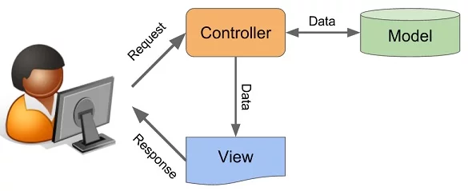
MVC REPRESENTATION

Slide 22
HOW DOES AN MVC WORK?
The user sends a request to the controller
The controller creates the model (if needed)
The controller prepares the view using the model (if needed)
The controller returns the view
The user sees the view
Repeat

Slide 23
DEMO: CREATE ASP.NET Core MVC WEB APP

Slide 24
ASP.NET CORE MVC FEATURES
Routing
Model binding
Model validation
Dependency injection
Filters
Areas
Web APIs
Razor view engine
Strongly typed views

Slide 25
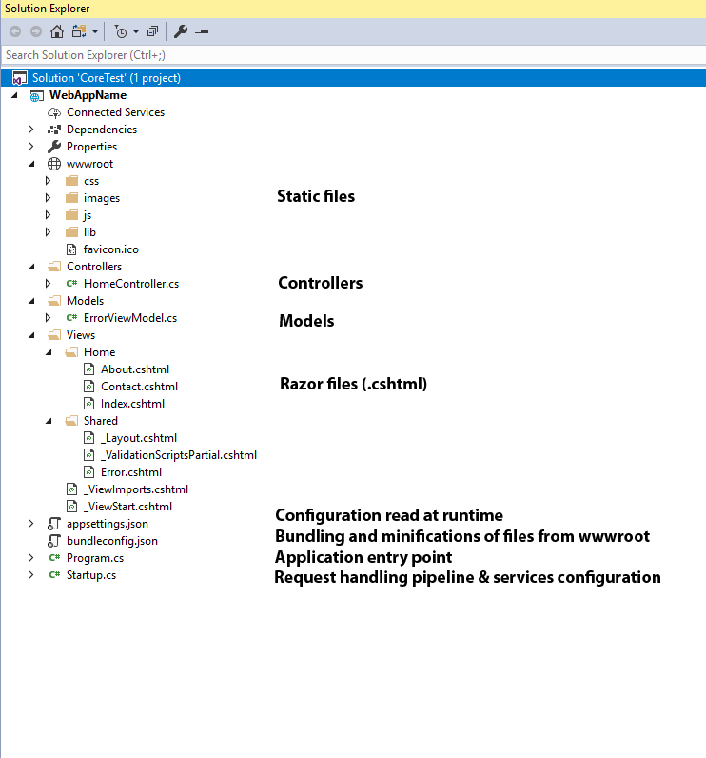
STRUCTURE

Slide 26
APPLICATION ENTRY POINT
public class Program
{
public static void Main(string[] args)
{
CreateHostBuilder(args).Build().Run();
}
public static IHostBuilder CreateHostBuilder(string[] args) =>
Host.CreateDefaultBuilder(args)
.ConfigureWebHostDefaults(webBuilder =>
{
webBuilder.UseStartup<Startup>();
});
}

Slide 27
STARTUP CLASS
Define request handling pipeline
Define services needed by the app

Slide 28
JUST RUN IT

Slide 29
WHAT RUNS INSIDE THAT CONSOLE?

Slide 30

KESTREL

Slide 31
KESTREL
Kestrel is an open source, cross platform, light-weight and a default web server used by ASP.NET Core applications.
Does not have advanced features of web servers like IIS, nginx, Apache, etc.
Due to its lightweight nature, Kestrel provides better request processing performance to ASP.NET Core applications.
Most times, used with a reverse proxy (e.g. IIS, nginx, etc.).

Slide 32
SOME STORIES ABOUT KESTREL
It uses that "useless" thing that we have never used in a real-life scenario: Binary Search.
Uses a lot of bitwise operations with masks (remember C?)
HTTP method names can be allocated on a long (8 bytes)
Uses Spans
Take a look at the youtube video called ASP.NET Core Kestrel: Adventures in building a fast web server - Damian Edwards & David Fowler if you want more information (https://www.youtube.com/watch?v=kej3YJDMAW4)

Slide 33
CONTROLLERS
Controllers, actions and action results are a fundamental part of how developers build apps using ASP.NET Core MVC
A controller is used to define and group a set of actions.
An action (or action method) is a method on a controller which handles requests.
Controllers logically group similar actions together.
Within the Model-View-Controller pattern, a controller is responsible for the initial
processing of the request and instantiation of the model. Generally, business
decisions should be performed within the model.

Slide 34
ROUTING

Slide 35
WHY WE ARE SEEING THIS?
ASP.NET Core MVC uses the Routing to match the URLs of incoming requests to map them to actions.
Routes are defined in startup or by using attributes
Routes describe how URL paths should be matched to actions.

Slide 36
ROUTES EXAMPLES
/Products/Details/5 URL path will attempt to locate a controller named ProductsController and run the action Details
public class ProductsController : Controller
{
public IActionResult Details(int id) {... }
}

Slide 37
ROUTING DETAILS
/Books URL path will attempt to locate a controller named BooksController and run the action Index.
/Books/GetBooksByAuthor?authorName=Oliver will attempt to run an action named GetBooksByAuthor containing a parameter named authorName.
public ActionResult GetBooksByAuthor(string authorName) {...}

Slide 38
RAZOR
Razor is a markup syntax for embedding service-based code into webpages.
Consists of Razor markup, C#, and HTML.
Files containing Razor generally have a .cshtml file extension.

Slide 39
RAZOR CODE BLOCKS
@{
var quote = "The future depends on what you do today";
}
<p>@quote</p>
@{
var quote = "Hate cannot drive out hate, only love can do that.";
}
<p>@quote</p>
--> Renders:
<p>The future depends on what you do today.</p>
<p>Hate cannot drive out hate, only love can do that.</p>

Slide 40
RAZOR CAN DO MORE
Looping @for, @foreach, @while, and @do while
Conditionals @if, else if, else, and @switch
@try, catch, finally
@using directive
@model LoginViewModel (model passed to a view)

Slide 41
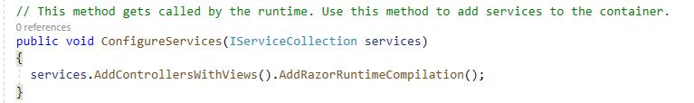
WHEN SHOULD I REBUILD?
Rebuild the project if you modify .cs files.
Rebuilding is NOT necessary when modifying Razor files (.cshtml), CSS, HTML, JS IF:
You install the following NuGet package: Microsoft.AspNetCore.Mvc.Razor.RuntimeCompilation
Inside Startup.cs > ConfigureServices method you add .AddRazorRuntimeCompilation()

Slide 42
IT IS NOT THAT SIMPLE

Slide 43
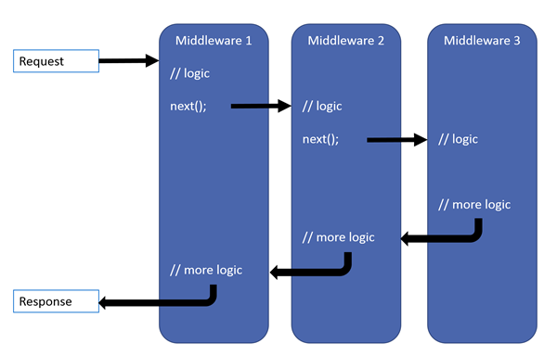
MIDDLEWARE (recap Startup)

Slide 44
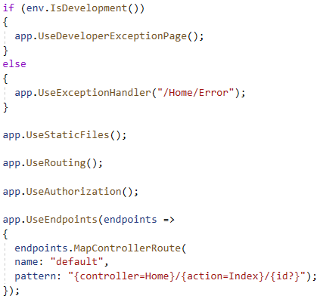
StaticFiles middleware - Case Study

Slide 45
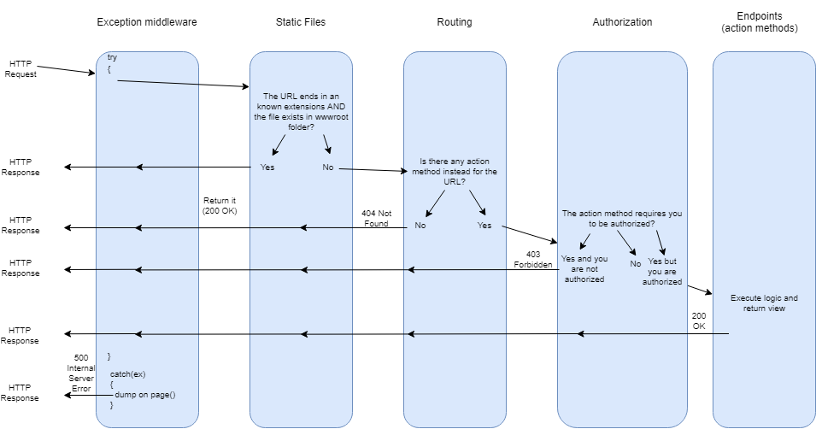

Slide 46
SIMPLE MIDDLEWARE
app.Use(async (context, next) =>
{
Console.WriteLine("Someone wants something from: " + context.Request.Path);
if (context.Request.Path.ToString().ToLower().Contains("admin"))
{
await context.Response.WriteAsync("Nope.");
return;
}
await next.Invoke();
});

Slide 47
CRUD - DEMO

